Slide 1
Disclaimer
These slides are intended as presentation aids for the lecture. They contain information that would otherwise be to difficult or time-consuming to reproduce on the board. But they are incomplete, not self-explanatory, and are not always used in the order they appear in this presentation. As a result, these slides should not be used as a script for this course. I recommend you take notes during class, maybe on the slides themselves. It has been shown that taking notes improves learning success.

Slide 2
Reading for this set of slides
Craig – Intro to Robotics (3rd Edition)
Chapter 5.6 (and Chapter 5 overall)
Please note that this set of slides is intended as support for the lecture, not as a
stand-alone script. If you want to study for this course, please use these slides
in conjunction with the indicated chapters in the text books. The textbooks are
available online or in the TUB library (many copies that can be checked out for the entire semester. There are also some aspects of the lectures that will not be
covered in the text books but can still be part of the homework or exam. For those
It is important that you attend class or ask somebody about what was covered in class.

Slide 3
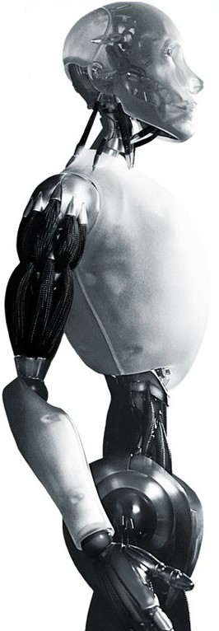
Robotics Computing the Jacobian
TU Berlin
Oliver Brock
TexPoint fonts used in EMF.
Read the TexPoint manual before you delete this box.: AAAAAA

Slide 4
Different Jacobians
So far we computed the Jacobian
wrt/ end-effector
for a given end-effector representation x
Jacobian can be computed for
any point
any representation
We want a uniquely defined Jacobian!

Slide 5
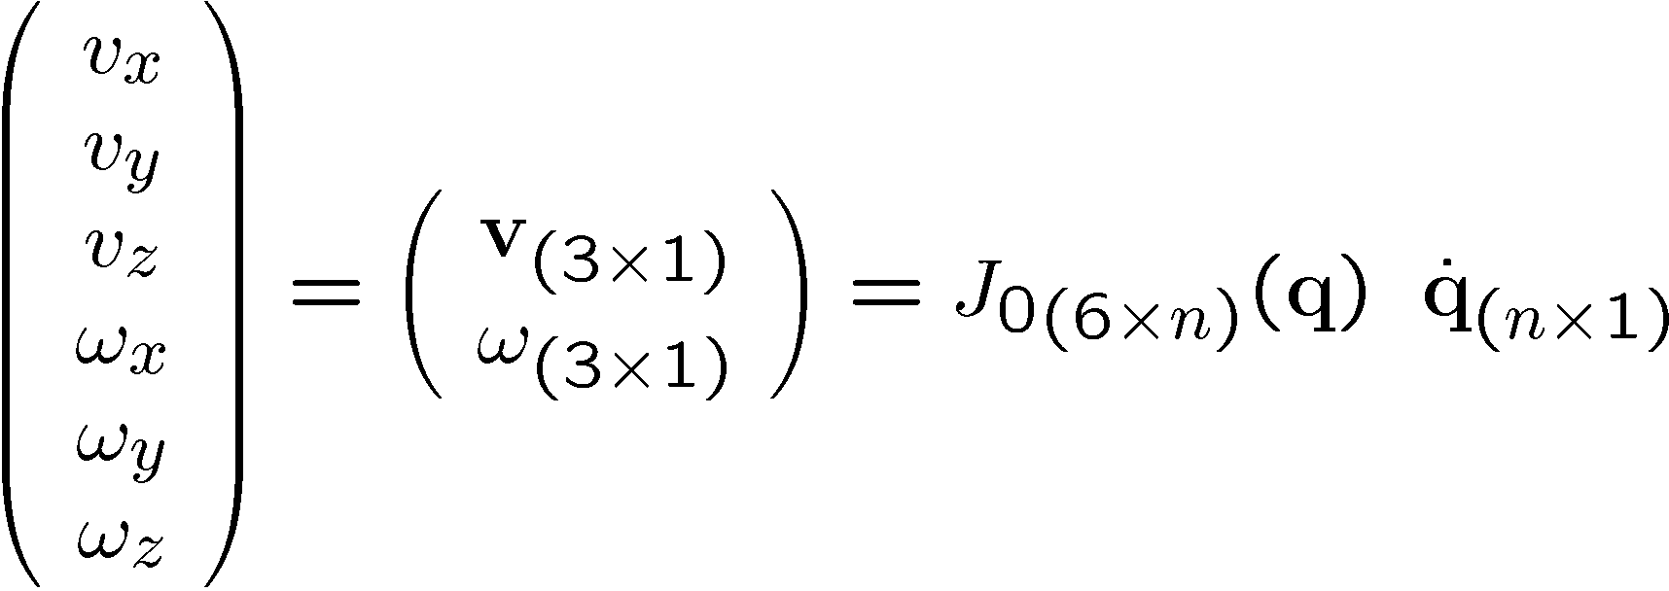
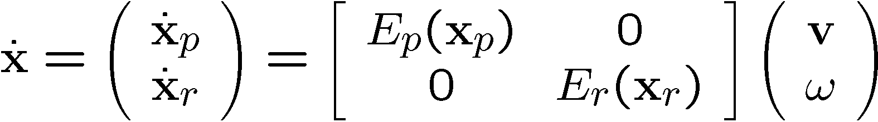
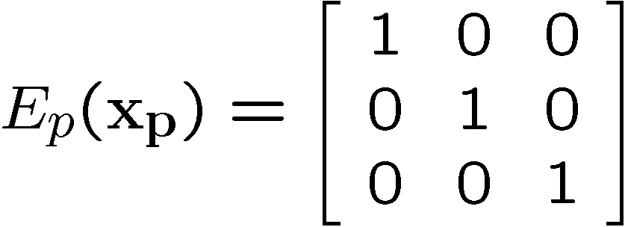
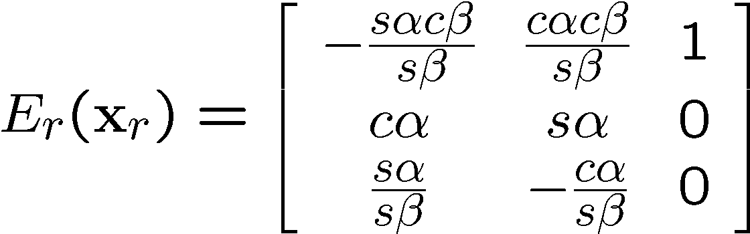
Basic Jacobian
For convenience, we will often drop the (q)
e.g., to convert from ω to α, β, γ Euler

Slide 6
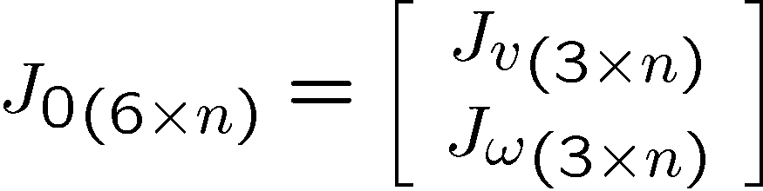
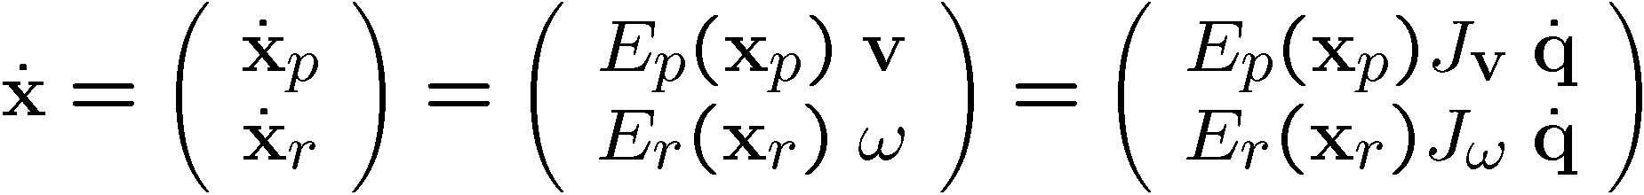
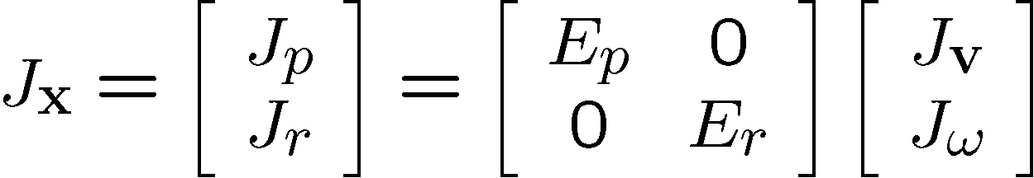
Relationship between J_{x} and J₀

Slide 7
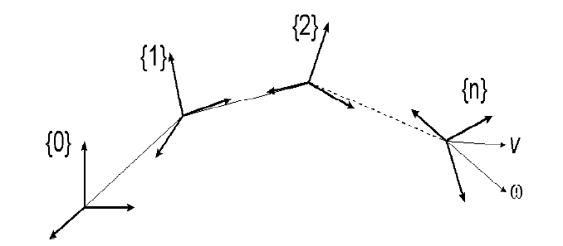
Velocity Propagation

Slide 8



Linear Motion
{A}
{A}
{B}

Slide 9
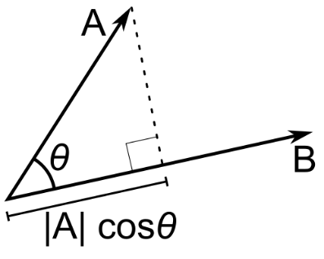

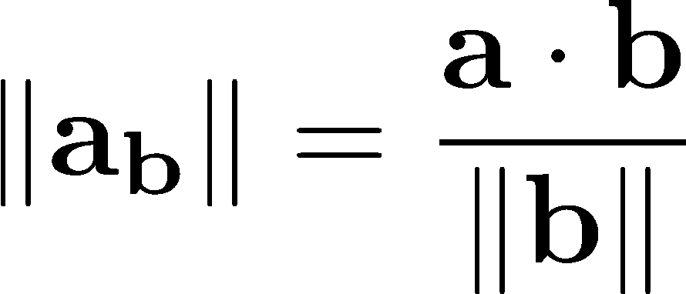



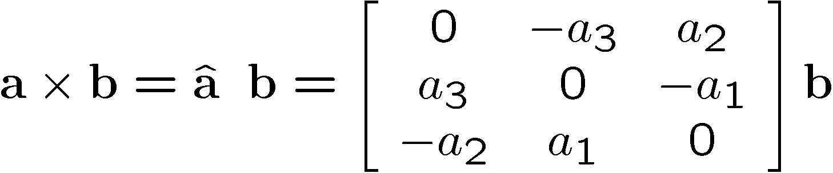


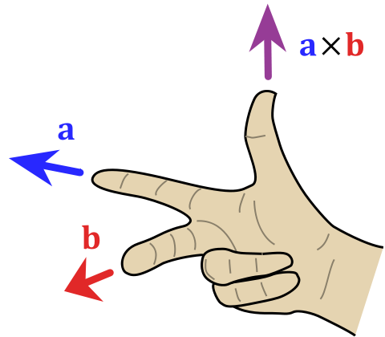


Sidebar: dot / cross product
dot product
skew-symmetric matrix
cross product
cross product operator

Slide 10





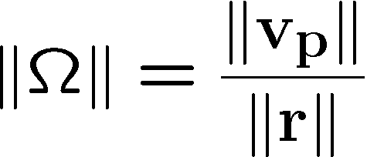

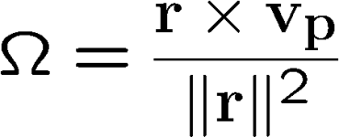
Rotational Motion
Angular Velocity
{A}

Slide 11




Side by Side
{A}

Slide 12



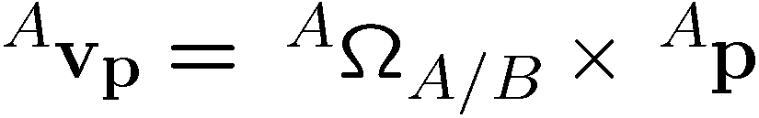
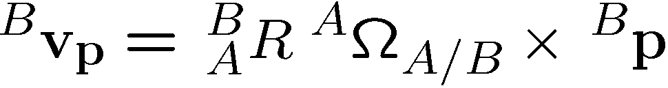
Velocity Between Rotating Frames
Considering rotation between {A} and {B}:
{B}
{A}

Slide 13

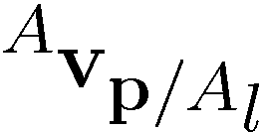

Linear and Angular Motion
From before:
Adding linear motion of p (possibly the result of linear and angular motion in {A}:
{B}
{A}
Adding linear motion between frames A and B:

Slide 14
Velocity Propagation

Slide 15







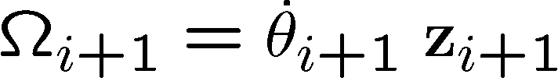


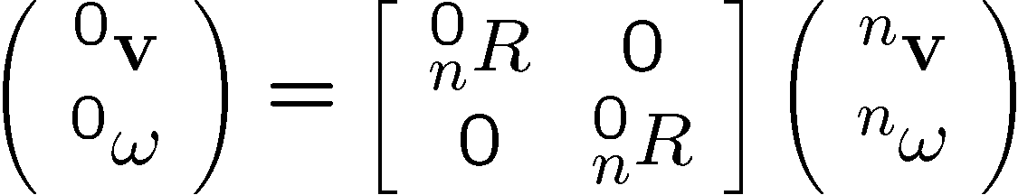
Velocity Propagation
{i}
{i+1}

Slide 16
Huh?
Velocity propagation gives us end-effector velocities based on joint velocities
That is exactly what the Jacobian does!
Velocity propagation only involved simple operations – no differentiation of the forward kinematics!
Can we use velocity propagation to easily compute the Jacobian?

Slide 17

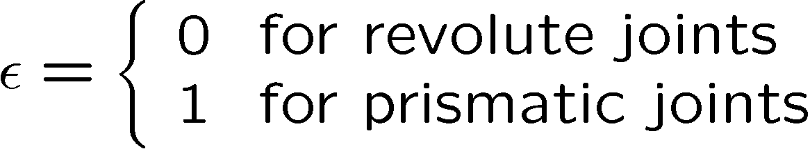

q revisited: Joint Coordinates

Slide 18

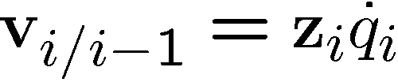
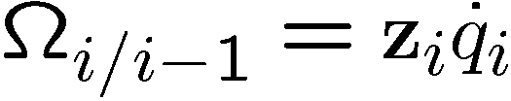

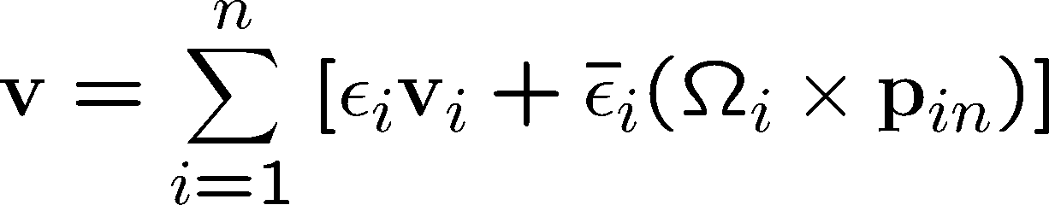
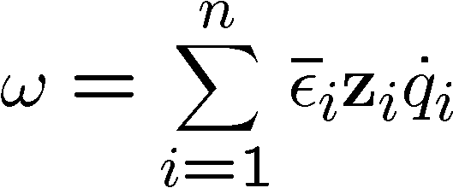
End-Effector Velocities
prismatic:
revolute:
we’ll drop these
End-Effector

Slide 19
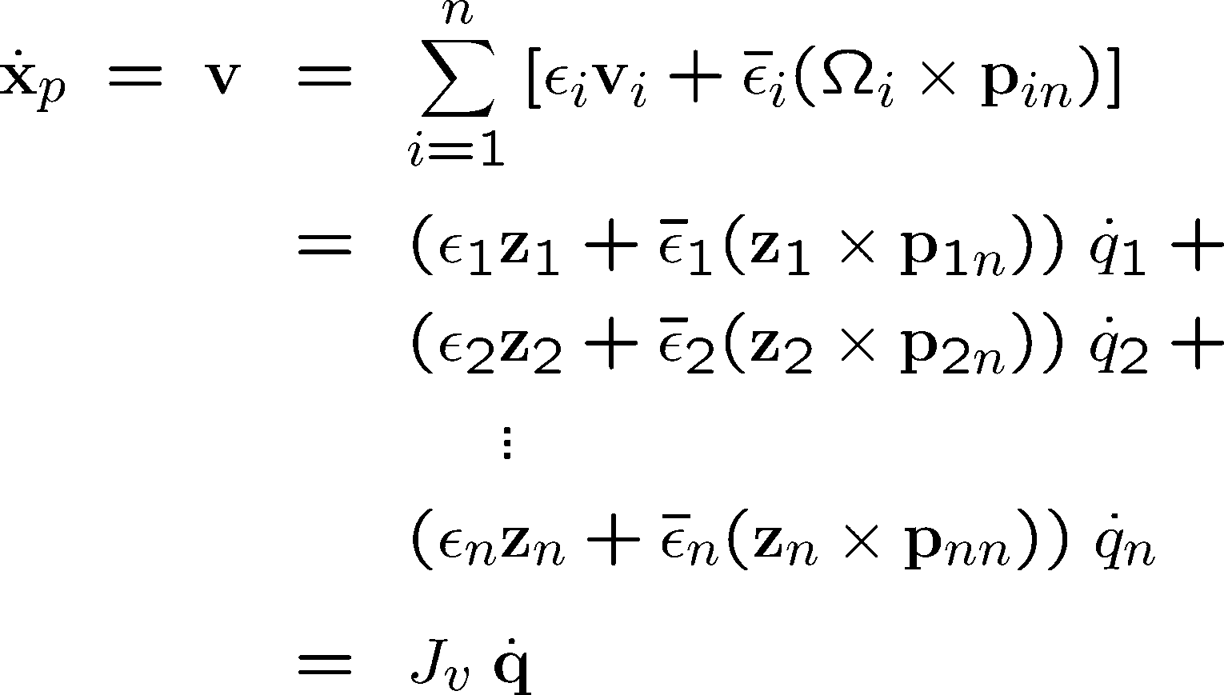
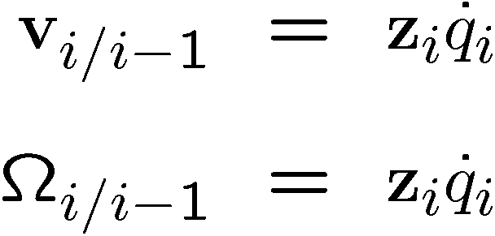
Linear End-Effector Velocities
i-th column of J_{v}

Slide 20
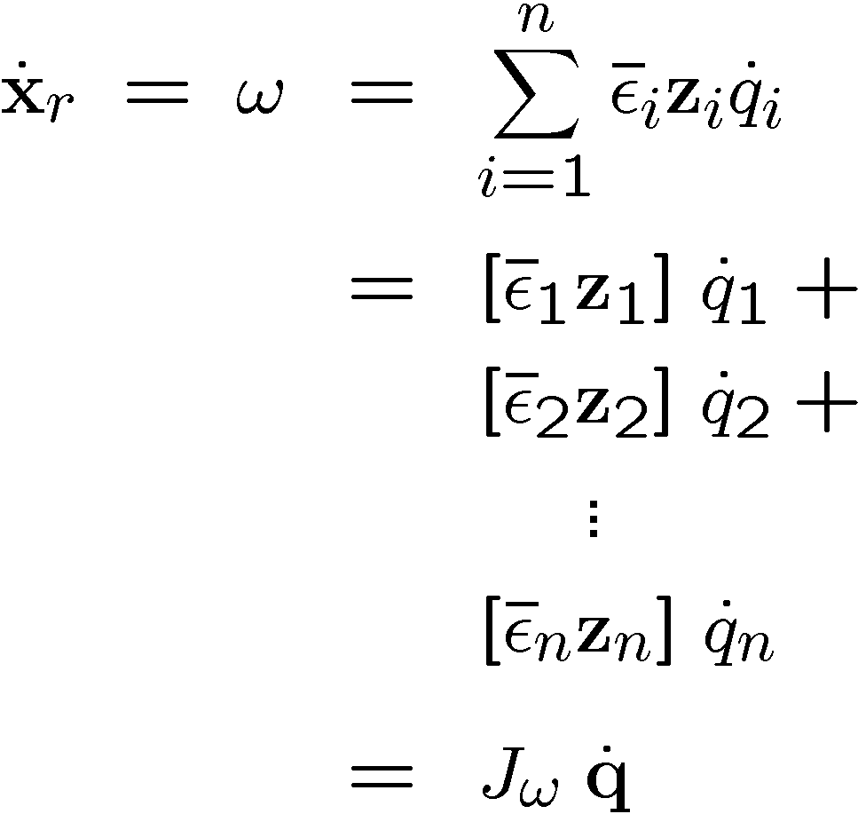
Angular End-Effector Velocities
i-th column of J_{ω}

Slide 21
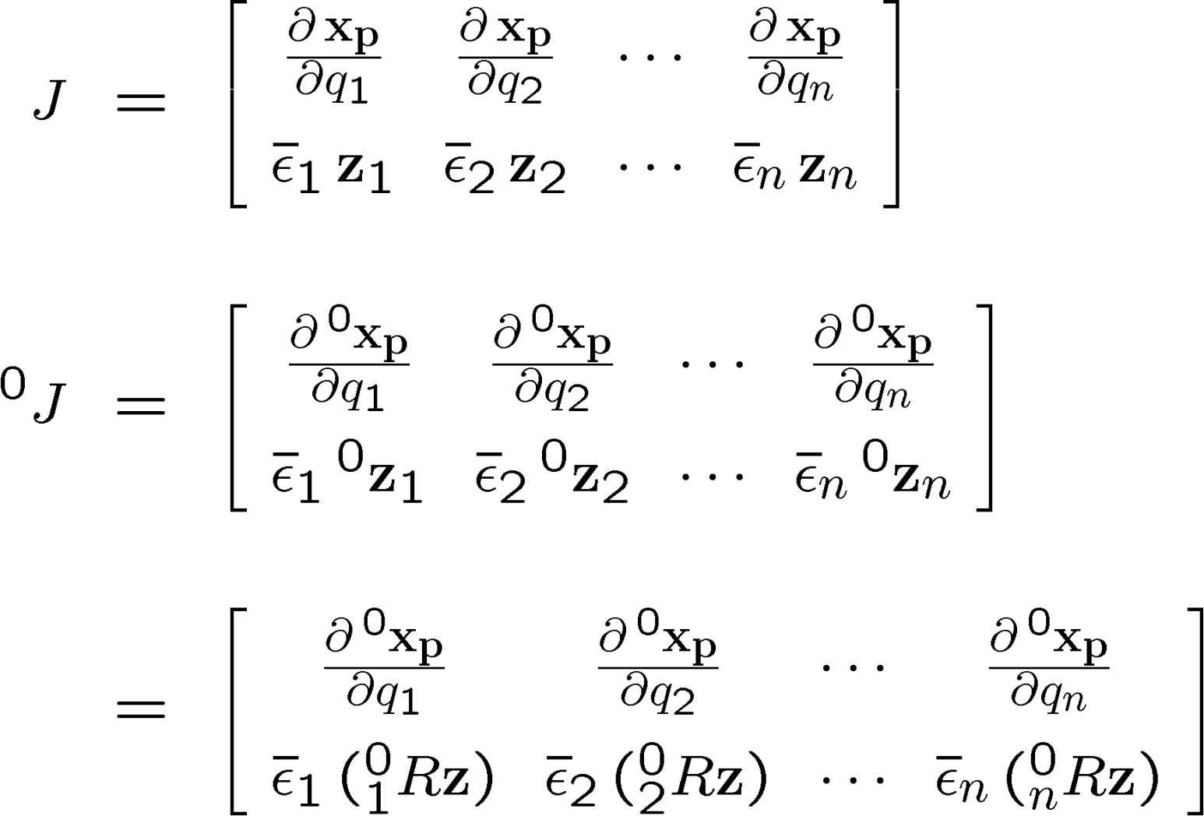
Jacobian Computation

Slide 22
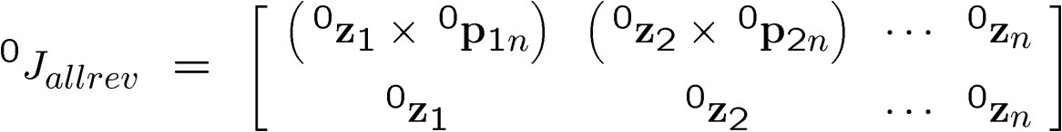
Jacobian Computation
Example: Jacobian for n revolute joint robot
All quantities are known from forward kinematics!!!

Slide 23


A Word about Reference Frames
Notes:
The way we have computed the Jacobian so far, we need to know the end-effector position before we can compute the Jacobian. This means that we have to “walk along” the kinematic structure twice, once for forward kinematics, once for computing the Jacobian. We can reduce this to a single pass by expressing the Jacobian in frame 0!

Slide 24
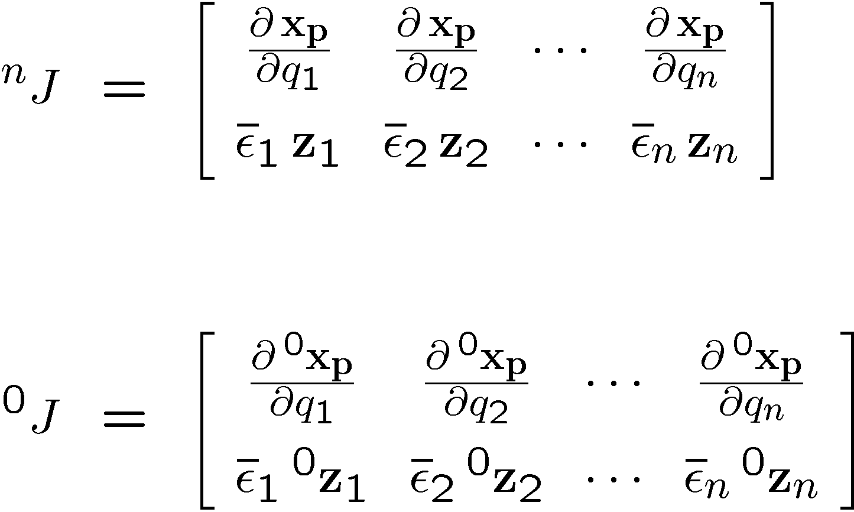
Jacobian in Different Frames

Slide 25
So far…
Mathematically motivated we saw the Jacobian for
infinitesimal displacements
velocities
forces
Some more Jacobian definitions
Physical understanding

Slide 26
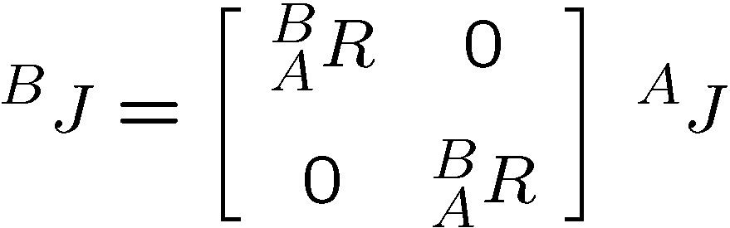
Moving J Between Frames
Notes:
Orientation only! What happens if you want to move the Jacobian between translated frames?

Slide 27

Notes:
Illustrate what happens when a 2DOF rotational robot arm loses 1 DOF
Background image
https://www.pexels.com/photo/background-black-blackboard-board-159770/

